Slide 1
Enhancing Performance with
PIPELINING

Slide 2
Pipelining
Pipeline concepts
Hazards
Example

Slide 3
Pipelined vs. Single-Cycle Instruction Execution
P
r
o
g
r
a
m
2
4
6
8
1
0
1
2
1
4
1
6
1
8
e
x
e
c
u
t
i
o
n
T
i
m
e
o
r
d
e
r
Single-cycle
(
i
n
i
n
s
t
r
u
c
t
i
o
n
s
)
l
w
$
1
,
1
0
0
(
$
0
)
I
n
s
t
r
u
c
t
i
o
n
R
e
g
A
L
U
D
a
t
a
R
e
g
f
e
t
c
h
a
c
c
e
s
s
l
w
$
2
,
2
0
0
(
$
0
)
8
n
s
I
n
s
t
r
u
c
t
i
o
n
R
e
g
A
L
U
D
a
t
a
R
e
g
f
e
t
c
h
a
c
c
e
s
s
l
w
$
3
,
3
0
0
(
$
0
)
8
n
s
I
n
s
t
r
u
c
t
i
o
n
f
e
t
c
h
.
.
.
8
n
s
Assume 2 ns for memory access, ALU operation; 1 ns for register access:
therefore, single cycle clock 8 ns; pipelined clock cycle 2 ns.
P
r
o
g
r
a
m
2
4
6
8
1
0
1
2
1
4
e
x
e
c
u
t
i
o
n
T
i
m
e
o
r
d
e
r
(
i
n
i
n
s
t
r
u
c
t
i
o
n
s
)
I
n
s
t
r
u
c
t
i
o
n
D
a
t
a
l
w
$
1
,
1
0
0
(
$
0
)
f
e
t
c
h
R
e
g
A
L
U
a
c
c
e
s
s
R
e
g
Pipelined
l
w
$
2
,
2
0
0
(
$
0
)
2
n
s
I
n
s
t
r
u
c
t
i
o
n
R
e
g
A
L
U
D
a
t
a
R
e
g
f
e
t
c
h
a
c
c
e
s
s
l
w
$
3
,
3
0
0
(
$
0
)
2
n
s
I
n
s
t
r
u
c
t
i
o
n
R
e
g
A
L
U
D
a
t
a
R
e
g
f
e
t
c
h
a
c
c
e
s
s
2
n
s
2
n
s
2
n
s
2
n
s
2
n
s

Slide 4
Pipeline Implementation
Pipelining
  Goal of MIPS: (Clock cycles Per Instruction) CPI <= 1
  Some instructions take longer to execute than others
  Don’t want cycle time to depend on slowest instruction
  Want 100% hardware utilization
  Split execution of each instruction into several, balanced “stages”
  Each stage is a block of combinational logic
  Latency of each stage fits within 1 clock cycle
  Insert registers between each pipeline stage to hold intermediate results
  Execute each of these steps in parallel for a sequence of instructions

Slide 5
Pipelining MIPS
MIPS characteristics make pipelining easy
  All instructions are approx. same length
    Fetch and decode stages are similar for all instructions
  Just a few instruction formats
    Simplifies instruction decode and makes it possible in one stage
  Memory operands appear only in load/stores
    Memory access can be deferred to exactly one later stage
  Operands are aligned in memory
    One data transfer instruction requires one memory access stage

Slide 6
MIPS pipeline stages
Fetch (IF)
  Read next instruction from memory
  Increment address counter
Decode (ID)
  Read register operands,
  Resolve instruction in control signals
  Compute branch target
Execute (EX)
  Execute arithmetic/resolve branches
Memory (MEM)
  Perform load/store accesses to memory
  Take branches
Write back (WB)
  Write arithmetic results to register file

Slide 7
Pipelined Datapath
Recall the 5 steps in instruction execution
  Instruction Fetch & PC Increment (IF)
  Instruction Decode and Register Read (ID)
  Execution or calculate address (EX)
  Memory access (MEM)
  Write result into register (WB)

Slide 8

Review - Single-Cycle Datapath “Steps”
ADD
4
ADD
PC
<<2
ADDR
RD
Instruction
I
Instruction
32
16
32
5
5
5
Memory
RN1
RN2
WN
Register File
RD1
ALU
Zero
WD
RD2
M
U
ADDR
X
Data
E
Memory
RD
M
16
X
32
U
T
WD
X
N
D
IF
Instruction Fetch
ID
Instruction Decode
EX
Execute/ Address Calc.
MEM
Memory Access
WB
Write Back

Slide 9
Pipelined Datapath – Key Idea
What happens if we break the execution into multiple cycles, but keep the extra hardware?
  Answer: We may be able to start executing a new instruction at each clock cycle - pipelining
…but we shall need extra registers to hold data between cycles – pipeline registers

Slide 10
Pipelined Datapath
Pipeline registers
wide enough to hold data coming in
ADD
4
64 bits
128 bits
ADD
PC
<<2
97 bits
64 bits
ADDR
RD
Instruction
I
Instruction
32
16
32
5
5
5
Memory
RN1
RN2
WN
Register File
RD1
ALU
Zero
WD
RD2
M
U
ADDR
X
Data
E
Memory
RD
M
16
X
32
U
T
WD
X
N
D
IF/ID
ID/EX
EX/MEM
MEM/WB

Slide 11
Pipelined Datapath
Pipeline registers
wide enough to hold data coming in
ADD
4
64 bits
128 bits
ADD
PC
<<2
97 bits
64 bits
ADDR
RD
Instruction
I
Instruction
32
16
32
5
5
5
Memory
RN1
RN2
WN
Register File
RD1
ALU
Zero
WD
RD2
M
Hazard-Situation that would cause incorrect execution
U
ADDR
X
Data
E
Memory
RD
M
16
X
32
U
T
WD
X
N
D
IF/ID
ID/EX
EX/MEM
MEM/WB
Only data flowing right to left may cause hazard…, why?

Slide 12
Bug in the Datapath
IF/ID
ID/EX
EX/MEM
MEM/WB
ADD
4
ADD
PC
<<2
ADDR
RD
Instruction
I
Instruction
32
16
32
5
5
5
Memory
RN1
RN2
WN
Register File
RD1
ALU
WD
RD2
M
U
ADDR
X
Data
E
Memory
RD
M
16
X
32
U
T
WD
X
N
D
Write register number comes from another later instruction!

Slide 13

Corrected Datapath
IF/ID
ID/EX
EX/MEM
MEM/WB
ADD
64 bits
133 bits
ADD
4
102 bits
69 bits
<<2
PC
ADDR
RD
32
5
RN1
RD1
Zero
Instruction
RN2
ALU
Memory
5
Register
5
WN
File
RD2
WD
M
ADDR
U
X
Data
E
Memory
RD
M
16
X
32
U
T
WD
X
N
5
D
Destination register number is also passed through ID/EX, EX/MEM
and MEM/WB registers, which are now wider by 5 bits

Slide 14
Pipelined Example
Consider the following instruction sequence:
lw $t0, 10($t1)
sw $t3, 20($t4)
add $t5, $t6, $t7
sub $t8, $t9, $t10

Slide 15
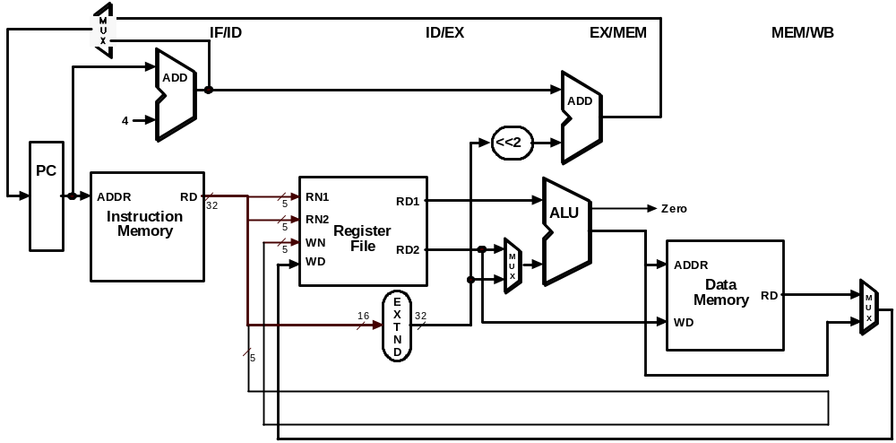
Single-Clock-Cycle Diagram:
Clock Cycle 1
LW
lw $t0, 10($t1)
sw $t3, 20($t4)
add $t5, $t6, $t7
sub $t8, $t9, $t10

Slide 16
Single-Clock-Cycle Diagram:
Clock Cycle 2
SW
LW
lw $t0, 10($t1)
sw $t3, 20($t4)
add $t5, $t6, $t7
sub $t8, $t9, $t10

Slide 17
Single-Clock-Cycle Diagram:
Clock Cycle 3
ADD
SW
LW
lw $t0, 10($t1)
sw $t3, 20($t4)
add $t5, $t6, $t7
sub $t8, $t9, $t10

Slide 18
Single-Clock-Cycle Diagram:
Clock Cycle 4
SUB
ADD
SW
LW
lw $t0, 10($t1)
sw $t3, 20($t4)
add $t5, $t6, $t7
sub $t8, $t9, $t10

Slide 19
Single-Clock-Cycle Diagram:
Clock Cycle 5
SUB
ADD
SW
LW
lw $t0, 10($t1)
sw $t3, 20($t4)
add $t5, $t6, $t7
sub $t8, $t9, $t10

Slide 20
Single-Clock-Cycle Diagram:
Clock Cycle 6
SUB
ADD
SW
lw $t0, 10($t1)
sw $t3, 20($t4)
add $t5, $t6, $t7
sub $t8, $t9, $t10

Slide 21
Single-Clock-Cycle Diagram:
Clock Cycle 7
SUB
ADD
lw $t0, 10($t1)
sw $t3, 20($t4)
add $t5, $t6, $t7
sub $t8, $t9, $t10

Slide 22
Single-Clock-Cycle Diagram:
Clock Cycle 8
SUB
lw $t0, 10($t1)
sw $t3, 20($t4)
add $t5, $t6, $t7
sub $t8, $t9, $t10

Slide 23
Represent Pipelines Graphically
Multiple instruction execution over multiple clock cycles
  Instructions are listed in execution order from top to bottom
  Clock cycles move from left to right
  Show the use of resources at each stage and each cycle

Slide 24
Represent Pipelines Graphically
Lw $t6, 8($s5)
Add $s1, $s2, $s3
Ori $s4, $t3, 7
Sub $t5, $s2, $t3
Sw $s2, 10($t3)

Slide 25
Graphically Representing Pipelines
Time (in cycles)
CC1
CC2
CC3
CC4
CC5
CC6
CC7
CC8
lw $t6, 8($s5)
add $s1, $s2, $s3
ori $s4, $t3, 7
sub $t5, $s2, $t3
sw $s2, 10($t3)
Reg
DM
lw $t6, 8($s5)
IM
ALU
Reg
add $s1, $s2, $s3
IM
Reg
ALU
DM
Reg
Program Execution Order
ori $s4, $t3, 7
IM
Reg
ALU
DM
Reg
sub $t5, $s2, $t3
IM
Reg
ALU
DM
Reg
sw $s2, 10($t3)
IM
Reg
ALU
DM

Slide 26
Instruction-Time Diagram
Instruction-Time Diagram shows:
  Which instruction occupying what stage at each clock cycle
Instruction flow is pipelined over the 5 stages
Lw $t7, 8($s3)
Lw $t6, 8($st)
Ori $t4, $s3, 7
Sub $s5, $s2, $t3
Sw $s2, 10($s3)

Slide 27
Instruction-Time Diagram
Up to five instructions can be in the pipeline during the same cycle
Instruction Level Parallelism (ILP)
ALU instructions skip the MEM stage. Store instructions skip the WB stage
lw $t7, 8($s3)
IF
ID
EX
MEM
WB
lw $t6, 8($s5)
IF
ID
EX
MEM
WB
Instruction Order
ori $t4, $s3, 7
IF
ID
EX
–
WB
sub $s5, $s2, $t3
IF
ID
EX
–
WB
sw $s2, 10($s3)
IF
ID
EX
MEM
–
  CC1
  CC2
  CC3
  CC4
  CC5
  CC6
  CC7
  CC8
  CC9
  Time
How many Clock Cycles?
5 Instructions + (5 step pipelining - 1) = 9 Clock cycles

Slide 28
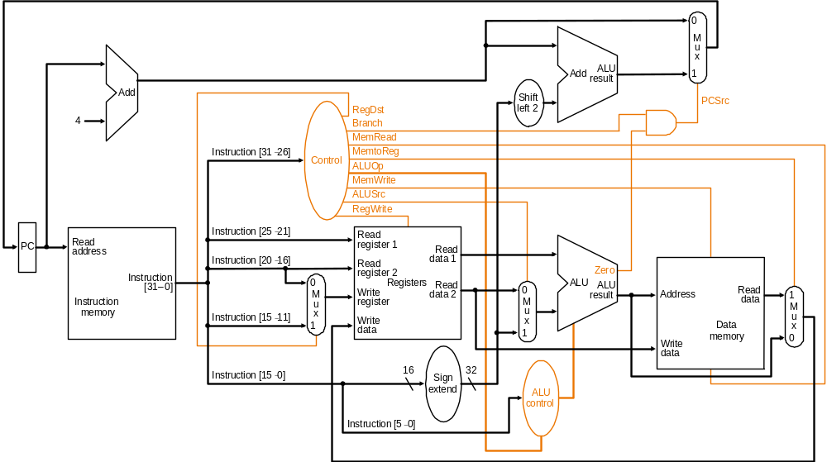
Recall Single-Cycle Control – the Datapath

Slide 29
Recall Single-Cycle – ALU Control
Instruction AluOp Instruction Funct Field Desired ALU control
opcode operation ALU action input
LW 00 load word xxxxxx add 010
SW 00 store word xxxxxx add 010
Branch eq 01 branch eq xxxxxx subtract 110
R-type 10 add 100000 add 010
R-type 10 subtract 100010 subtract 110
R-type 10 AND 100100 and 000
R-type 10 OR 100101 or 001
R-type 10 set on less 101010 set on less 111
ALUOp
Funct field
Operation
ALUOp1
ALUOp0
F5
F4
F3
F2
F1
F0
0
0
X
X
X
X
X
X
010
0
1
X
X
X
X
X
X
110
1
X
X
X
0
0
0
0
010
1
X
X
X
0
0
1
0
110
1
X
X
X
0
1
0
0
000
1
X
X
X
0
1
0
1
001
1
X
X
X
1
0
1
0
111
Truth table for ALU control bits

Slide 30
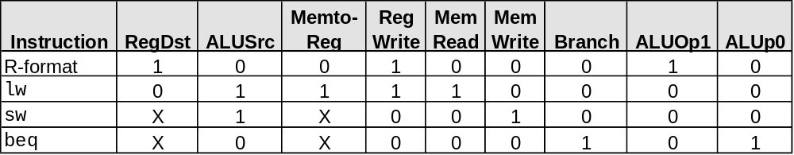
Recall Single-Cycle – Control Signals
Effect of control bits
Signal Name Effect when deasserted Effect when asserted
RegDst The register destination number for the The register destination number for the
Write register comes from the rt field (bits 20-16) Write register comes from the rd field (bits 15-11)
RegWrite None The register on the Write register input is written
with the value on the Write data input
AlLUSrc The second ALU operand comes from the The second ALU operand is the sign-extended,
second register file output (Read data 2) lower 16 bits of the instruction
PCSrc The PC is replaced by the output of the adder The PC is replaced by the output of the adder
that computes the value of PC + 4 that computes the branch target
MemRead None Data memory contents designated by the address
input are put on the first Read data output
MemWrite None Data memory contents designated by the address
input are replaced by the value of the Write data input
MemtoReg The value fed to the register Write data input The value fed to the register Write data input
comes from ALU comes from the data memory
Deter-
mining
control
bits

Slide 31
Pipeline Control
Initial design – motivated by single-cycle datapath control – use the same control signals
Modified Signals:
  No separate write signal for the PC as it is written every cycle
  No separate write signals for the pipeline registers as they are written every cycle
  No separate read signal for instruction memory as it is read every clock cycle
  No separate read signal for register file as it is read every clock cycle
Need to set control signals during each pipeline stage
Since control signals are associated with components active during a single pipeline stage, can group control lines into five groups according to pipeline stage
Will be
modified
by hazard
detection
unit!!

Slide 32
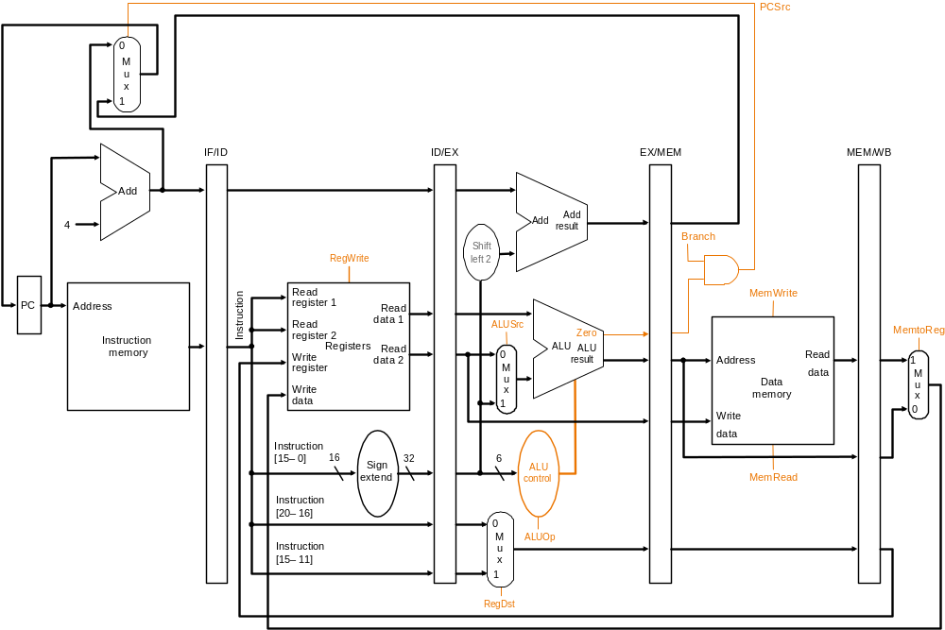
Pipelined Datapath with Control I
Same control
signals as the
single-cycle
datapath

Slide 33
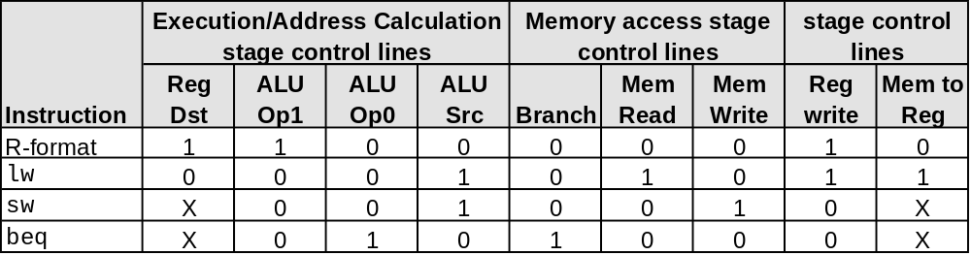
Pipeline Control Signals
There are five stages in the pipeline
  instruction fetch / PC increment
  instruction decode / register fetch
  execution / address calculation
  memory access
  write back
Nothing to control as instruction memory
read and PC write are always enabled

Slide 34
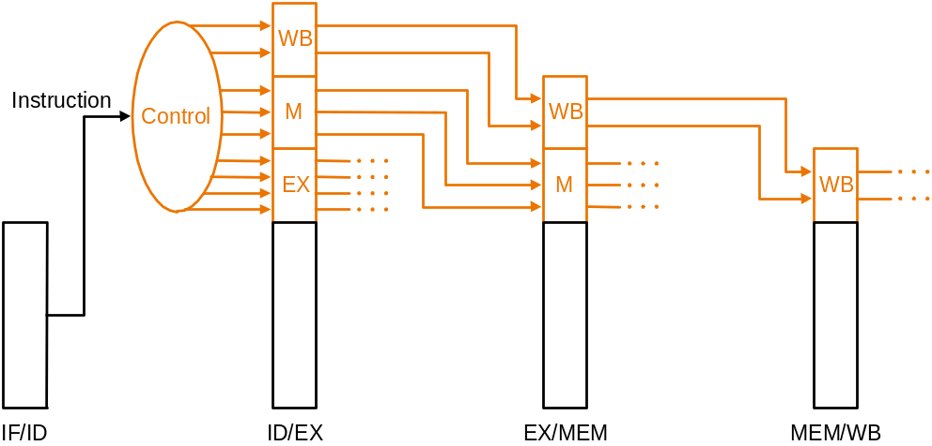
Pipeline Control Implementation
Pass control signals along just like the data – extend each pipeline register to hold needed control bits for succeeding stages
Note: The 6-bit funct field of the instruction required in the EX stage to generate ALU control can be retrieved as the 6 least significant bits of the immediate field which is sign-extended and passed from the IF/ID register to the ID/EX register

Slide 35
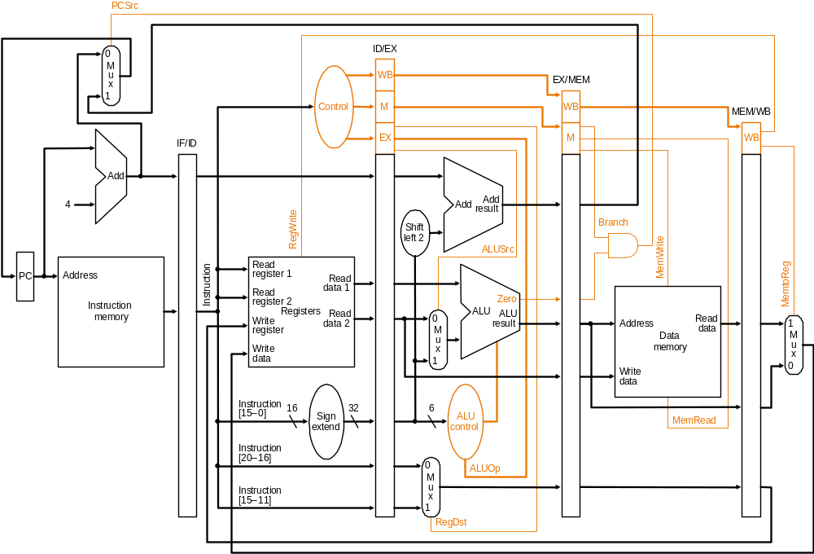
Pipelined Datapath with Control II
Control signals
emanate from
the control
portions of the
pipeline registers

Slide 36
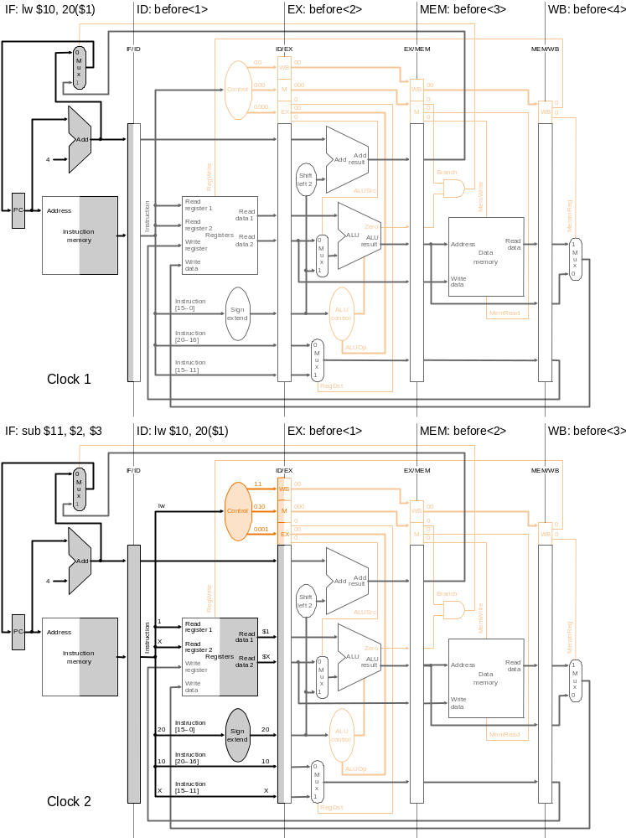
Pipelined
Execution and
Control
Clock cycle 1
Instruction sequence:
Dark Right Area indicates the Read Operation
Dark Left Area indicates the Write Operation
lw $10, 20($1)
sub $11, $2, $3
and $12, $4, $7
or $13, $6, $7
add $14, $8, $9
Label “before<i>” means
i th instruction before
lw
Clock cycle 2

Slide 37
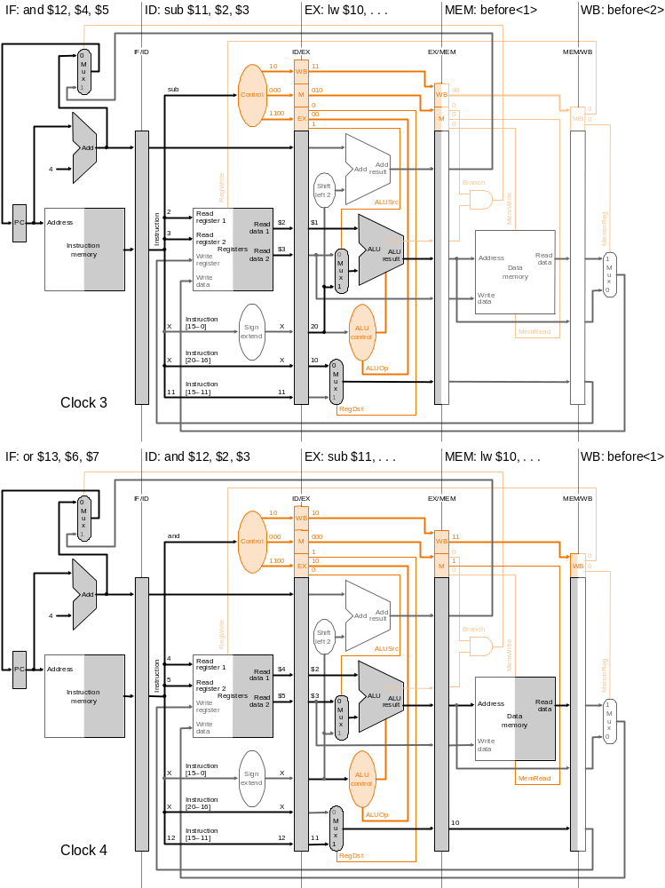
Pipelined
Execution
and
Control
Clock cycle 3
Instruction
sequence:
lw $10, 20($1)
sub $11, $2, $3
and $12, $4, $7
or $13, $6, $7
add $14, $8, $9
Clock cycle 4

Slide 38
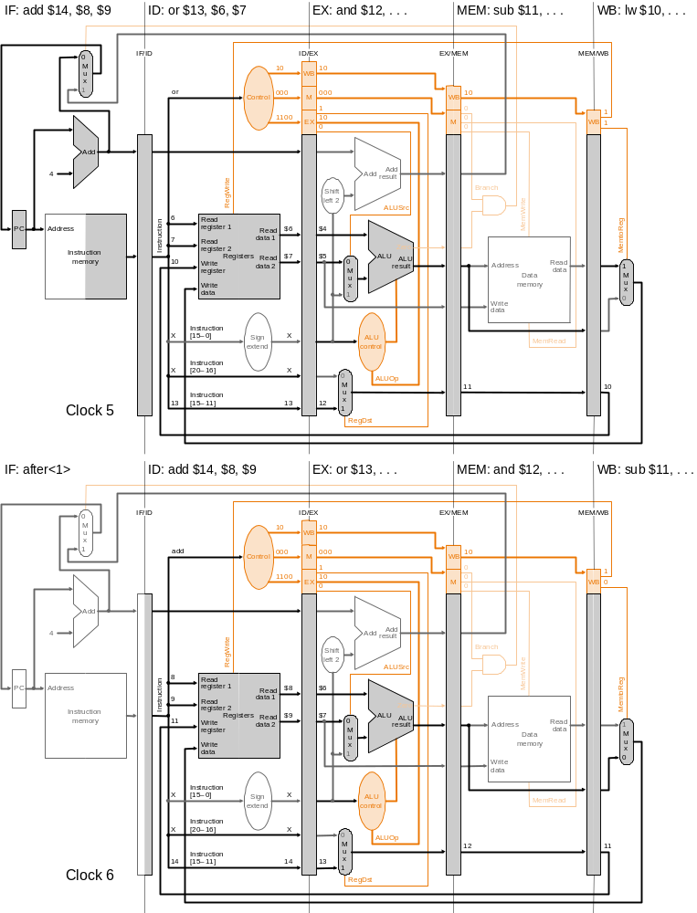
Pipelined
Execution
and
Control
Clock cycle 5
Instruction
sequence:
lw $10, 20($1)
sub $11, $2, $3
and $12, $4, $7
or $13, $6, $7
add $14, $8, $9
Label “after<i>” means
i th instruction after add
Clock cycle 6

Slide 39
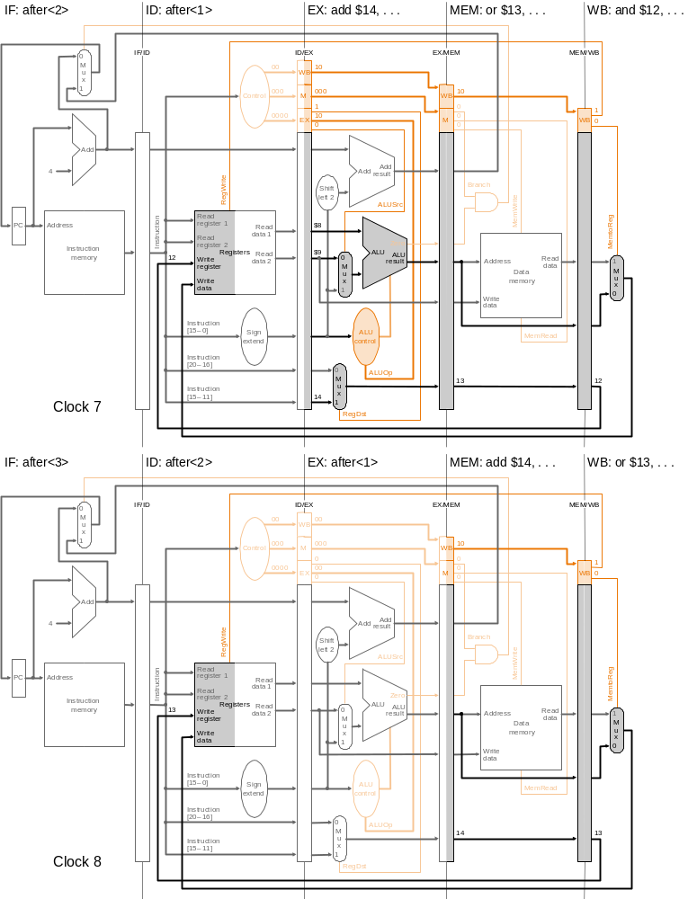
Pipelined
Execution
and
Control
Clock cycle 7
Instruction
sequence:
lw $10, 20($1)
sub $11, $2, $3
and $12, $4, $7
or $13, $6, $7
add $14, $8, $9
Clock cycle 8

Slide 40
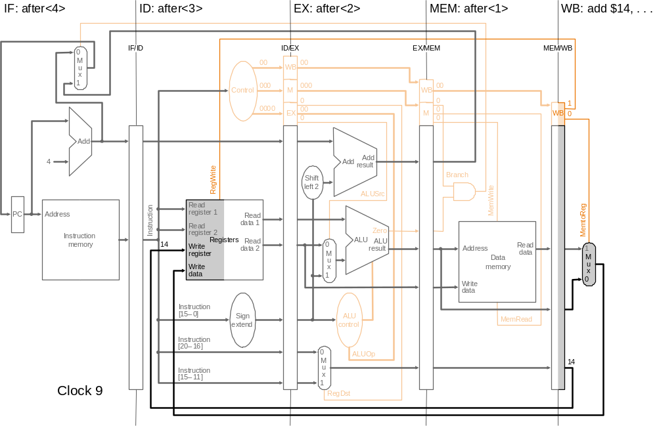
Pipelined Execution and Control
Instruction
sequence:
lw $10, 20($1)
sub $11, $2, $3
and $12, $4, $7
or $13, $6, $7
add $14, $8, $9
Clock cycle 9

Slide 41
Pipeline Hazards
Situations that would cause incorrect execution
Data flow problems that arise as a result of pipelining
  Limits the amount of parallelism, sometimes induces “penalties” that prevent one instruction per clock cycle
Types
  Structural hazards
  Data hazards
  Control hazards

Slide 42
Pipeline Hazards
Structural hazards
  Caused by resource contention
  Two operations require a single piece of hardware e.g. Memory
  Using same resource by two instructions during the same cycle
  Structural hazards can be overcome by adding additional hardware
Data hazards
Control hazards

Slide 43
Pipeline Hazards
Structural hazards
  Caused by resource contention
  Two operations require a single piece of hardware e.g. Memory
  Using same resource by two instructions during the same cycle
  Structural hazards can be overcome by adding additional hardware
Data hazards
  Instruction from one pipeline stage is “dependant” of data computed in previous pipeline stage
  Hardware can detect dependencies between instructions
Control hazards

Slide 44
Pipeline Hazards
Structural hazards
  Caused by resource contention
  Two operations require a single piece of hardware e.g. Memory
  Using same resource by two instructions during the same cycle
  Structural hazards can be overcome by adding additional hardware
Data hazards
  Instruction from one pipeline stage is “dependant” of data computed in previous pipeline stage
  Hardware can detect dependencies between instructions
Control hazards
  Caused by instructions that change control flow (branches/jumps)
    i.e. delays in changing the flow of control
  Requiring subsequent instruction fetches to be predicted
    Flushed if prediction does not hold (make sure no state change)
  Branch hazards can use dynamic prediction/speculation, branch delay slot

Slide 45
Hazards
Draw pipeline diagram, and check hazard is exist or not?
lw $1, 100($0)
lw $2, 200($0)
lw $3, 300($0)
lw $4, 400($0)

Slide 46
Hazard
e
x
e
c
u
t
i
o
n
2
4
6
8
1
0
1
2
1
4
o
r
d
e
r
T
i
m
e
(
i
n
i
n
s
t
r
u
c
t
i
o
n
s
)
l
w
$
1
,
1
0
0
(
$
0
)
I
n
s
t
r
u
c
t
i
o
n
R
e
g
A
L
U
D
a
t
a
R
e
g
f
e
t
c
h
a
c
c
e
s
s
l
w
$
2
,
2
0
0
(
$
0
)
2
n
s
I
n
s
t
r
u
c
t
i
o
n
R
e
g
A
L
U
D
a
t
a
R
e
g
f
e
t
c
h
a
c
c
e
s
s
l
w
$
3
,
3
0
0
(
$
0
)
2
n
s
I
n
s
t
r
u
c
t
i
o
n
R
e
g
A
L
U
D
a
t
a
R
e
g
f
e
t
c
h
a
c
c
e
s
s
lw $4, 400($0)
2
n
s
2
n
s
2
n
s
2
n
s
2
n
s

Slide 47
Structural Hazards
E.g., suppose single – not separate – instruction and data memory in pipeline below with one read port
  then a structural hazard between first and fourth lw instructions
P
r
o
g
r
a
m
e
x
e
c
u
t
i
o
n
2
4
6
8
1
0
1
2
1
4
o
r
d
e
r
T
i
m
e
(
i
n
i
n
s
t
r
u
c
t
i
o
n
s
)
l
w
$
1
,
1
0
0
(
$
0
)
I
n
s
t
r
u
c
t
i
o
n
R
e
g
A
L
U
D
a
t
a
R
e
g
Pipelined
f
e
t
c
h
a
c
c
e
s
s
l
w
$
2
,
2
0
0
(
$
0
)
2
n
s
I
n
s
t
r
u
c
t
i
o
n
R
e
g
A
L
U
D
a
t
a
R
e
g
Hazard if single memory
f
e
t
c
h
a
c
c
e
s
s
l
w
$
3
,
3
0
0
(
$
0
)
2
n
s
I
n
s
t
r
u
c
t
i
o
n
R
e
g
A
L
U
D
a
t
a
R
e
g
f
e
t
c
h
a
c
c
e
s
s
l
w
$
4
,
4
0
0
(
$
0
)
I
n
s
t
r
u
c
t
i
o
n
R
e
g
A
L
U
D
a
t
a
R
e
g
2
n
s
f
e
t
c
h
a
c
c
e
s
s
2
n
s
2
n
s
2
n
s
2
n
s
2
n
s

Slide 48
Structural Hazards
Inadequate hardware to simultaneously support all instructions in the pipeline in the same clock cycle
Attempt to use the same hardware resource by two different instructions during the same cycle
lw $1, 100($0)
lw $2, 200($0)
lw $3, 300($0)
lw $4, 400($0)

Slide 49
Resolving Structural Hazards
Serious Hazard:
  Hazard cannot be ignored
  Easy to avoid
Solution: Add more hardware resources (more costly)
  Add more additional hardware to eliminate the structural hazard
  Like, two separate memories

Slide 50
Data Hazards
Dependency between instructions causes a data hazard
Instruction needs data from the result of a previous instruction still executing in pipeline
The dependent instructions are close to each other
  Pipelined execution might change the order of operand access

Slide 51
Data Hazards Type
RAR (Read After Read) hazard
  Occurs when two instructions both read from the same register
  Example:
    ADD $s1, $s2, $s3
    SUB $s4, $s5, $s3
  Both instructions reading $s3, creating a RAR hazard
  Don't cause a problem for the processor because reading a register doesn't change the register‘s value

Slide 52
Data Hazards Type
RAW (Read After Write) hazard
  Occurs when, one instruction reads a location after an earlier instruction writes new data to it
  instruction j tries to read a source before instruction i writes it, so j incorrectly gets the old value
  Example:
  i: Add $s3, $s1, $s2
  j: Add $s5, $s3, $s4
  Result is the instruction reading stale data
  Detected when Output_{n} register ($s3) and Input_{n+1} registers ($s3, $s4) contain at least one common register
  Need to resolve

Slide 53
Data Hazards Type
WAR (Write After Read) hazard
  Hazards occur when the output register of an instruction is used for write after read by a previous instruction
  Instruction j tries to write a destination before it is read by instruction i, so i incorrectly gets the new value
  Example:
  i: Add $s3, $s1, $s2
  j: Add $s1, $s3, $s4
  Detected when Input_{n} register and Output_{n+1} register contain at least one common operand
  Such hazards are rare

Slide 54
Data Hazards Type
WAW (Write After Write) hazard
  Hazard occur when the output register of an instruction is used for write after written by a previous instruction
  Example:
  ADD $s1, $s2, $s3
  SUB $s1, $s5, $s6 //Subtract writes the same register as the addition
  If a processor executes instructions in the order that they appear in the program and uses the same pipeline for all instructions, WAR and WAW hazards do not cause the delays because of the way instructions flow through the pipeline

Slide 55
Hazard
Example: Draw pipeline diagram and show
the hazards if any.
sub $s2, $t1, $t3
add $s4, $s2, $t5
or $s6, $t3, $s2
and $s7, $t4, $s2
sw $t8, 10($s2)

Slide 56
RAW Data Hazard Solutions
Example:
sub $s2, $t1, $t3
add $s4, $s2, $t5
or $s6, $t3, $s2
and $s7, $t4, $s2
sw $t8, 10($s2)

Slide 57
RAW Data Hazard Solutions
Example:
sub $s2, $t1, $t3
add $s4, $s2, $t5
or $s6, $t3, $s2
and $s7, $t4, $s2
sw $t8, 10($s2)

Slide 58
Example of a RAW Data Hazard
Time (cycles)
CC1
CC2
CC3
CC4
CC5
CC6
CC7
CC8
value of $s2
10
10
10
10
10
20
20
20
sub $s2, $t1, $t3
IM
Reg
ALU
DM
Reg
add $s4, $s2, $t5
IM
Reg
ALU
DM
Reg
Program Execution Order
or $s6, $t3, $s2
IM
Reg
ALU
DM
Reg
and $s7, $t4, $s2
IM
Reg
ALU
DM
Reg
sw $t8, 10($s2)
IM
Reg
ALU
DM
Result of sub is needed by add, or, and, & sw instructions
Instructions add & or will read old value of $s2 from reg file
During CC5, $s2 is written at end of cycle, old value is read
  But, can be eliminated by considering in first half write to register and in second half read from register

Slide 59
Solution 1: Stalling the Pipeline
Time (in cycles)
CC1
CC2
CC3
CC4
CC5
CC6
CC7
CC8
CC9
value of $s2
10
10
10
10
10
20
20
20
20
sub $s2, $t1, $t3
IM
Reg
ALU
DM
Reg
Instruction Order
add $s4, $s2, $t5
IM
Reg
Reg
Reg
Reg
ALU
DM
Reg
stall
stall
stall
or $s6, $t3, $s2
IM
Reg
ALU
DM
Three stall cycles during CC3 thru CC5 (wasting 3 cycles)
  Stall cycles delay execution of add & fetching of or instruction
The add instruction cannot read $s2 until beginning of CC6
  The add instruction remains in the Instruction register until CC6
  The PC register is not modified until beginning of CC6

Slide 60
Solution 2: Forwarding ALU Result
The ALU result is forwarded (fed back) to the ALU input
  No bubbles are inserted into the pipeline and no cycles are wasted
ALU result is forwarded from ALU, MEM, and WB stages
Time (cycles)
CC1
CC2
CC3
CC4
CC5
CC6
CC7
CC8
value of $s2
10
10
10
10
10
20
20
20
sub $s2, $t1, $t3
IM
Reg
ALU
DM
Reg
add $s4, $s2, $t5
IM
Reg
ALU
DM
Reg
Program Execution Order
or $s6, $t3, $s2
IM
Reg
ALU
DM
Reg
and $s7, $s6, $s2
IM
Reg
ALU
DM
Reg
sw $t8, 10($s2)
IM
Reg
ALU
DM

Slide 61
RAW Data Hazard Solutions
For the following code, detect the hazard, if any.
lw $s0, 20($t1)
sub $t2, $s0,$t3
Is forwarding useful?
If an R-type instruction following a load uses the result of the load – called load-use data hazard

Slide 62
RAW Data Hazard Solutions
Unfortunately, not all data hazards can be forwarded
  Load has a delay that cannot be eliminated by forwarding
In the example shown below …
  The LW instruction does not read data until end of CC4
  Cannot forward data to ADD at end of CC3 - NOT possible
Time (cycles)
CC1
CC2
CC3
CC4
CC5
CC6
CC7
CC8
However, load can forward data to 2nd next and later instructions
lw $s2, 20($t1)
IF
Reg
ALU
DM
Reg
Program Order
add $s4, $s2, $t5
IF
Reg
ALU
DM
Reg
or $t6, $t3, $s2
IF
Reg
ALU
DM
Reg
and $t7, $s2, $t4
IF
Reg
ALU
DM
Reg

Slide 63
Stall the Pipeline for one Cycle
ADD instruction depends on LW ➔ stall at CC3
  Allow Load instruction in ALU stage to proceed
  Freeze PC and Instruction registers (NO instruction is fetched)
  Introduce a bubble into the ALU stage (bubble is a NO-OP)
Load can forward data to next instruction after delaying it
Time (cycles)
CC1
CC2
CC3
CC4
CC5
CC6
CC7
CC8
lw $s2, 20($s1)
IM
Reg
ALU
DM
Reg
add $s4, $s2, $t5
IM
stall
bubble
bubble
bubble
Program Order
Reg
ALU
DM
Reg
or $t6, $s3, $s2
IM
Reg
ALU
DM
Reg

Slide 64
Showing Stall Cycles
Stall cycles can be shown on instruction-time diagram
Hazard is detected in the Decode stage
Stall indicates that instruction is delayed
Instruction fetching is also delayed after a stall
Example:
Data forwarding is to be shown using green arrows
lw $s1, ($t5)
IF
ID
EX
MEM
WB
lw $s2, 8($s1)
IF
Stall
ID
EX
MEM
WB
add $v0, $s2, $t3
IF
Stall
ID
EX
MEM
WB
sub $v1, $s2, $v0
IF
ID
EX
MEM
WB
  CC1
  CC2
  CC3
  CC4
  CC5
  CC6
  CC7
  CC8
  CC9
  CC10
  Time

Slide 65
Showing Stall Cycles
Stall cycles can be shown on instruction-time diagram
Hazard is detected in the Decode stage
Stall indicates that instruction is delayed
Instruction fetching is also delayed after a stall
Example:
Data forwarding is shown using green arrows
lw $s1, ($t5)
IF
ID
EX
MEM
WB
lw $s2, 8($s1)
IF
Stall
ID
EX
MEM
WB
add $v0, $s2, $t3
IF
Stall
ID
EX
MEM
WB
sub $v1, $s2, $v0
IF
ID
EX
MEM
WB
  CC1
  CC2
  CC3
  CC4
  CC5
  CC6
  CC7
  CC8
  CC9
  CC10
  Time

Slide 66
RAW Data Hazard Solutions
Software Solution
  Reordering Code to Avoid Pipeline Stall
Example:
lw $t0, 0($t1)
lw $t2, 4($t1)
sw $t2, 0($t1)
sw $t0, 4($t1)

Slide 67
RAW Data Hazard Solutions
Example:
lw $t0, 0($t1)
lw $t2, 4($t1)
sw $t2, 0($t1)
sw $t0, 4($t1)
Reordered code:
lw $t0, 0($t1)
lw $t2, 4($t1)
sw $t0, 4($t1)
sw $t2, 0($t1)
Data hazard
Interchanged

Slide 68
Example
Draw the pipelining execution for the following code and detect and resolve the hazard, if any.
sub $2, $1, $3
and $12, $2, $5
or $13, $6, $2
add $14, $2, $2
sw $15, 100($2)
$2 = 10 before sub
$2 = -20 after sub

Slide 69
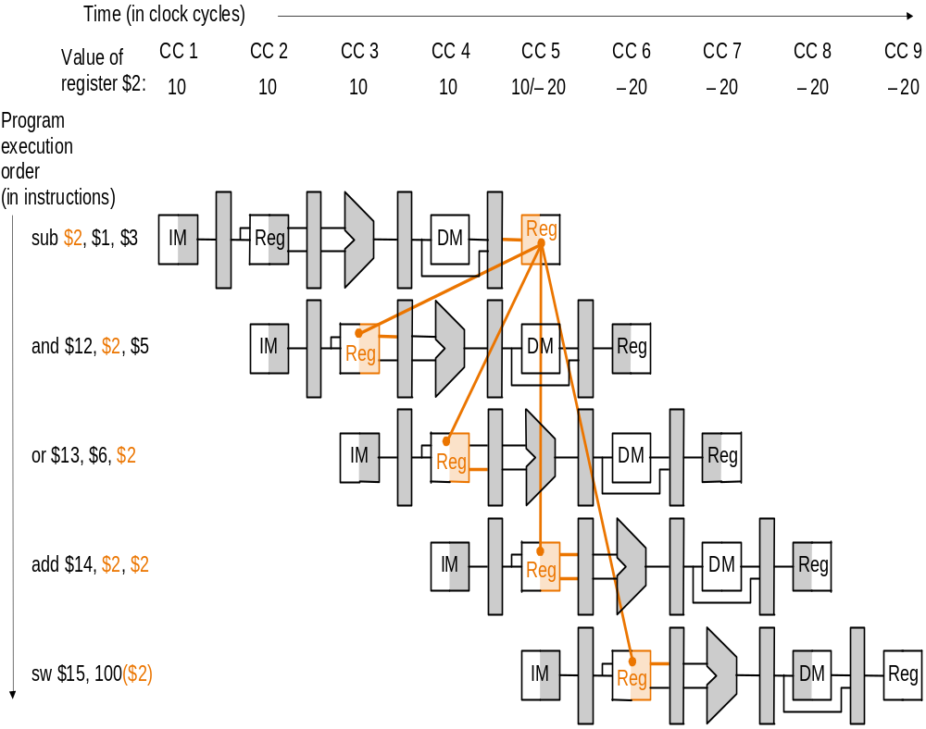
Data Hazards and Forwarding
$2 = 10 before sub;
$2 = -20 after sub

Slide 70
Example: Software Solution
  By rearranging instructions to insert independent instructions between instructions that would otherwise have a data hazard between them,
  Or, if such rearrangement is not possible, insert nops
Such compiler solutions may not always be possible, and nops slow the machine down
sub $2, $1, $3
and $12, $2, $5
or $13, $6, $2
add $14, $2, $2
sw $15, 100($2)
  sub $2, $1, $3
lw $10, 40($3)
slt $5, $6, $7
and $12, $2, $5
or $13, $6, $2
add $14, $2, $2
sw $15, 100($2)
  sub $2, $1, $3
nop
nop
and $12, $2, $5
or $13, $6, $2
add $14, $2, $2
sw $15, 100($2)
or
MIPS: nop = “no operation” = 00…0 (32bits) = sll $0, $0, 0

Slide 71
RAW Hazard-Hardware Solution
Forwarding
Idea: Use intermediate data, do not wait for result to be finally written to the destination register.
Two steps:
  Detect data hazard
  Forward intermediate data to resolve hazard

Slide 72
Pipelined Datapath with Control II (as before)
  sub $2, $1, $3
  and $12, $2, $5
  or $13, $6, $2
  add $14, $2, $2
  sw $15, 100($2)
Control signals
emanate from
the control
portions of the
pipeline registers

Slide 73
Data Hazards and Forwarding
$2 = 10 before sub;
$2 = -20 after sub
  First hazard between
    sub $2, $1, $3 and
    and $12, $2, $5 is detected
  When the sub is in EX stage and the and is in ID stage because
    EX/MEM.RegisterRd = ID/EX.RegisterRs = $2

Slide 74
Hazard Detection
Hazard conditions:
1a. EX/MEM.RegisterRd = ID/EX.RegisterRs
1b. EX/MEM.RegisterRd = ID/EX.RegisterRt
2a. MEM/WB.RegisterRd = ID/EX.RegisterRs
2b. MEM/WB.RegisterRd = ID/EX.RegisterRt
  Eg., in the example, first hazard between
    sub $2, $1, $3 and
    and $12, $2, $5 is detected
  When the sub is in EX stage and the and is in ID stage because
    EX/MEM.RegisterRd = ID/EX.RegisterRs = $2 (1a)
  sub $2, $1, $3
  and $12, $2, $5
  or $13, $6, $2
  add $14, $2, $2
  sw $15, 100($2)

Slide 75
Hazard Detection
  sub $2, $1, $3
  and $12, $2, $5
  or $13, $6, $2
  add $14, $2, $2
  sw $15, 100($2)
  When the sub is in WB stage and the or is in ID stage
  MEM/WB.RegisterRd = ID/EX.RegisterRt = $2 (2b)

Slide 76
Hazard Detection
Whether to forward also depends on:
  if the later instruction is going to write a register
    if not, no need to forward
  if the destination register of the later instruction is $0
    no need to forward value ($0 is always 0 and never overwritten)

Slide 77
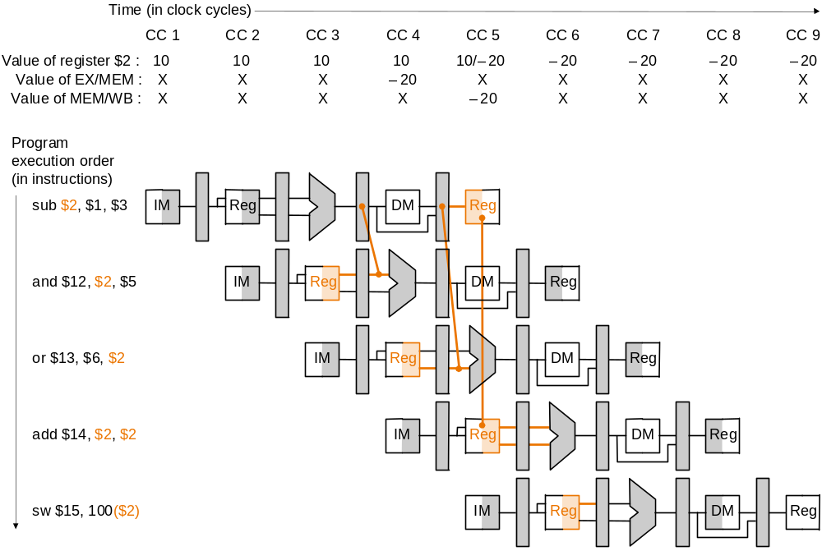
Data Forwarding
Plan:
  Allow inputs to the ALU not just from ID/EX, but also later pipeline registers, and
  Use multiplexors and control signals to choose appropriate inputs to ALU
sub $2, $1, $3
and $12, $2, $5
or $13, $6, $2
add $14, $2, $2
sw $15, 100($2)
Dependencies between pipelines move forward in time

Slide 78
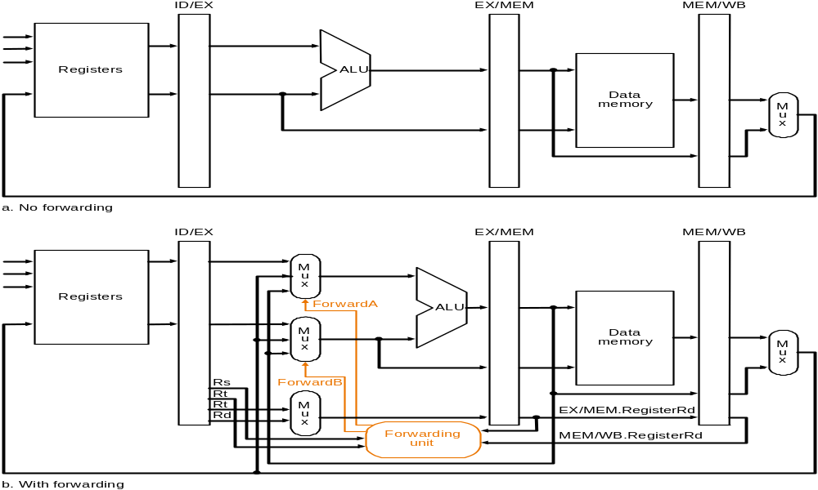
Datapath Before Forwarding Hardware
Datapath after adding forwarding hardware

Slide 79
Datapath after adding Forwarding Hardware
Forwarding Hardware

Slide 80
Forwarding Hardware: Multiplexor Control
Mux control Source Explanation
ForwardA = 00 ID/EX The first ALU operand comes from the register file
ForwardA = 10 EX/MEM The first ALU operand is forwarded from prior ALU result
ForwardA = 01 MEM/WB The first ALU operand is forwarded from data memory
or an earlier ALU result
ForwardB = 00 ID/EX The second ALU operand comes from the register file
ForwardB = 10 EX/MEM The second ALU operand is forwarded from prior ALU result
ForwardB = 01 MEM/WB The second ALU operand is forwarded from data memory
or an earlier ALU result
Depending on the selection in the rightmost multiplexor
(see datapath with control diagram)

Slide 81
Data Hazard: Detection and Forwarding
Forwarding unit determines multiplexor control according to the following rules:
EX hazard
if ( EX/MEM.RegWrite // if there is a write…
and ( EX/MEM.RegisterRd ≠ 0 ) // to a non-$0 register…
and ( EX/MEM.RegisterRd = ID/EX.RegisterRs ) ) // matches, then ForwardA = 10
if ( EX/MEM.RegWrite // if there is a write…
and ( EX/MEM.RegisterRd ≠ 0 ) // to a non-$0 register…
and ( EX/MEM.RegisterRd = ID/EX.RegisterRt ) ) // matches then… ForwardB = 10

Slide 82
Data Hazard: Detection and Forwarding
MEM hazard
if ( MEM/WB.RegWrite // if there is a write…
and ( MEM/WB.RegisterRd ≠ 0 ) // to a non-$0 register…
and ( EX/MEM.RegisterRd ≠ ID/EX.RegisterRs ) // and not already a //register match with earlier pipeline register…
and ( MEM/WB.RegisterRd = ID/EX.RegisterRs ) ) // but match with later //pipeline register, then…
ForwardA = 01
if ( MEM/WB.RegWrite // if there is a write…
and ( MEM/WB.RegisterRd ≠ 0 ) // to a non-$0 register…
and ( EX/MEM.RegisterRd ≠ ID/EX.RegisterRt ) // and not already a
// register match with earlier pipeline register…
and ( MEM/WB.RegisterRd = ID/EX.RegisterRt ) ) // but match with later pipeline register, then…
ForwardB = 01
This check is necessary, e.g., for sequences such as add $1, $1, $2; add $1, $1, $3; add $1, $1, $4;
(array summing…), where an earlier pipeline (EX/MEM) register has more recent data

Slide 83
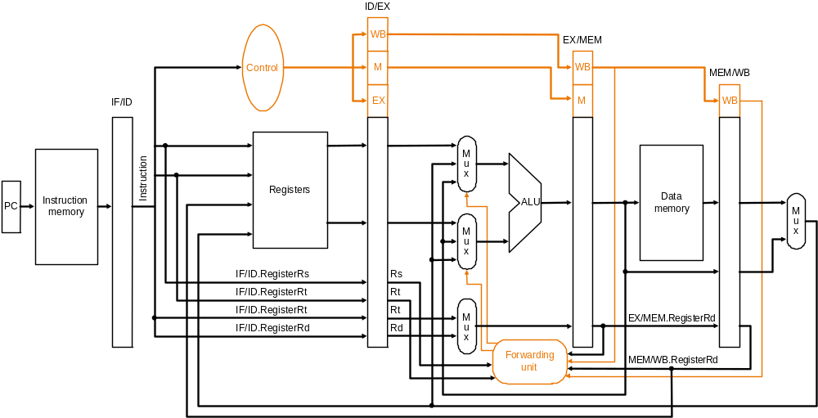
Forwarding Hardware with Control
Called forwarding unit, not hazard detection unit,
because once data is forwarded there is no hazard!
Datapath with forwarding hardware and control wires – certain details,
e.g., branching hardware, are omitted to simplify the drawing
Note: so far we have only handled forwarding to R-type instructions…!

Slide 84
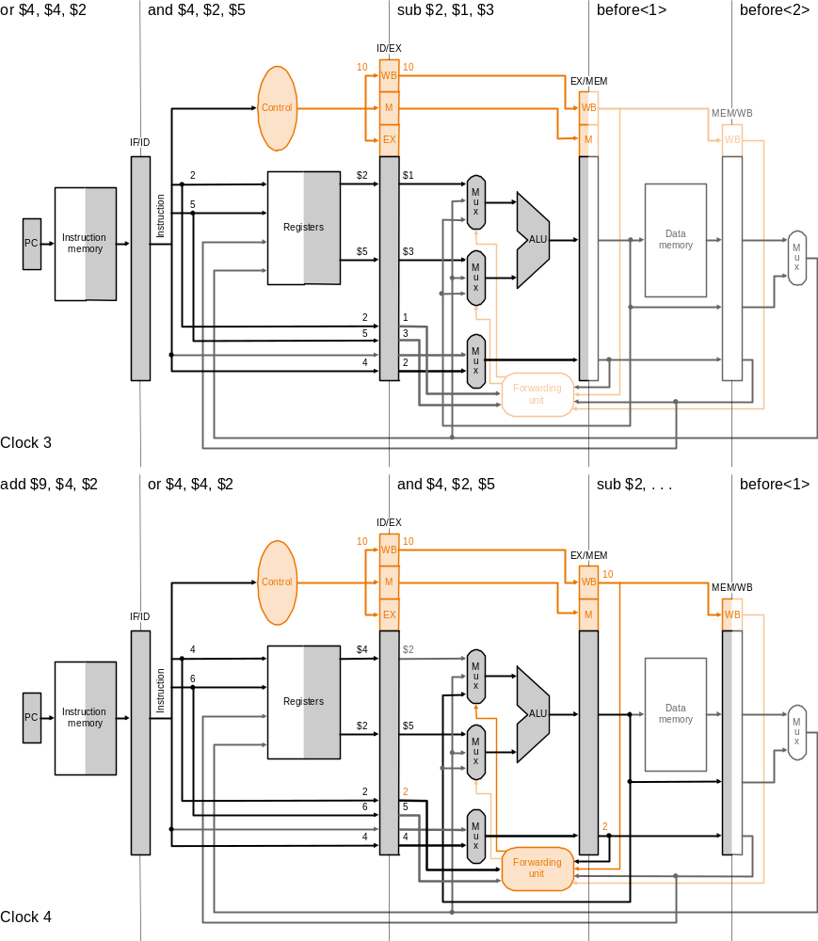
Forwarding
Clock cycle 3
Execution
example:
sub $2, $1, $3
and $4, $2, $5
or $4, $4, $2
add $9, $4, $2
Clock cycle 4

Slide 85
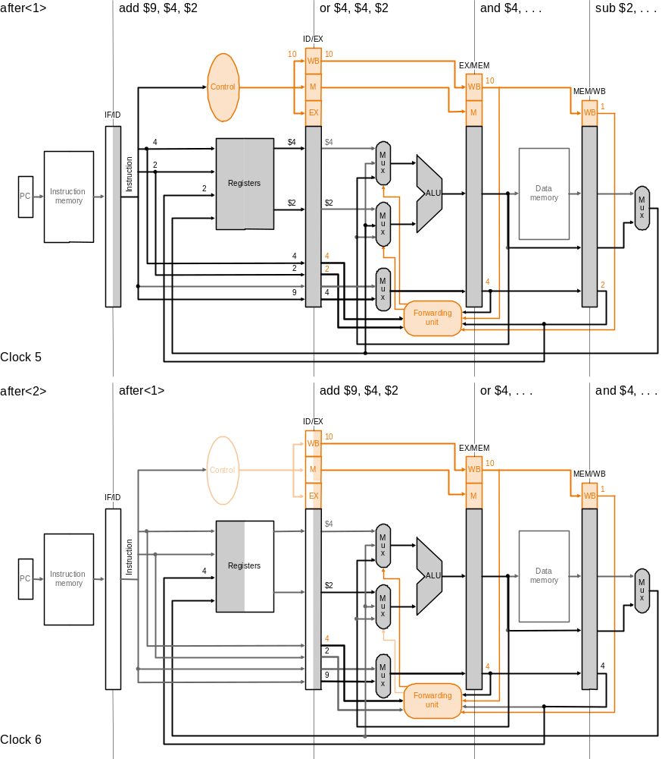
Forwarding
Execution
example
(cont.):
Clock cycle 5
sub $2, $1, $3
and $4, $2, $5
or $4, $4, $2
add $9, $4, $2
Clock cycle 6

Slide 86
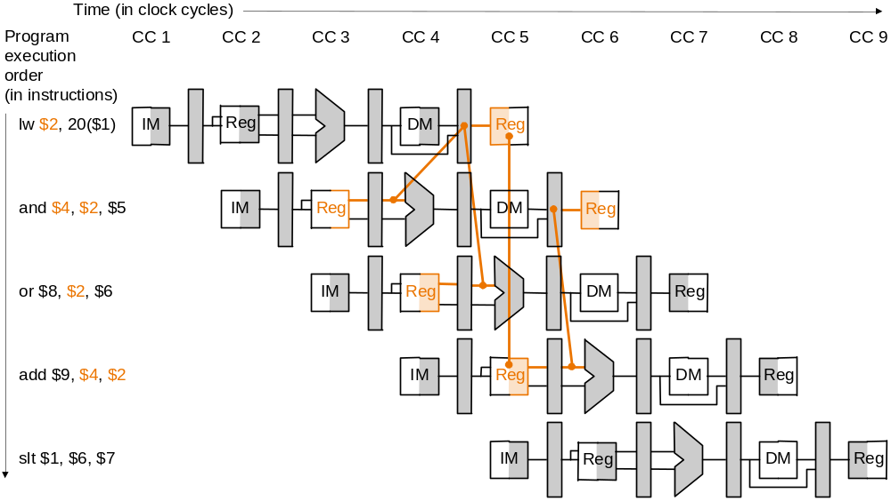
Data Hazards and Stalls
Load word can cause a hazard:
  An instruction tries to read a register following a load instruction that writes to the same register
Therefore, we need a hazard detection unit to stall the pipeline after the load instruction
lw $2, 20($1)
and $4, $2, $5
or $8, $2, $6
add $9, $4, $2
Slt $1, $6, $7
As even a pipeline
dependency goes
backward in time
forwarding will not
solve the hazard

Slide 87
Pipelined Datapath with Control II (as before)
Hazard Detection Unit
Control signals
emanate from
the control
portions of the
pipeline registers

Slide 88
Hazard Detection Logic to Stall
Hazard detection unit implements the following check at ID stage, if to stall by inserting a bubble into the pipeline by changing the EX, MEM and WB control fields of the ID/EX pipeline register to 0
if ( ID/EX.MemRead // if the instruction in the EX stage is a load…
and ( ( ID/EX.RegisterRt = IF/ID.RegisterRs ) // and the destination register
or ( ID/EX.RegisterRt = IF/ID.RegisterRt ) ) ) // matches either source register
STALL // of the instruction in the ID stage, then…stall the pipeline
Insert a bubble into the EX stage after a load instruction
  Bubble is a no-op that wastes one clock cycle
  By deasserting all nine control signals (setting them to 0) in EX, MEM and WB stages
    Restrict the write operation to any register or memory

Slide 89
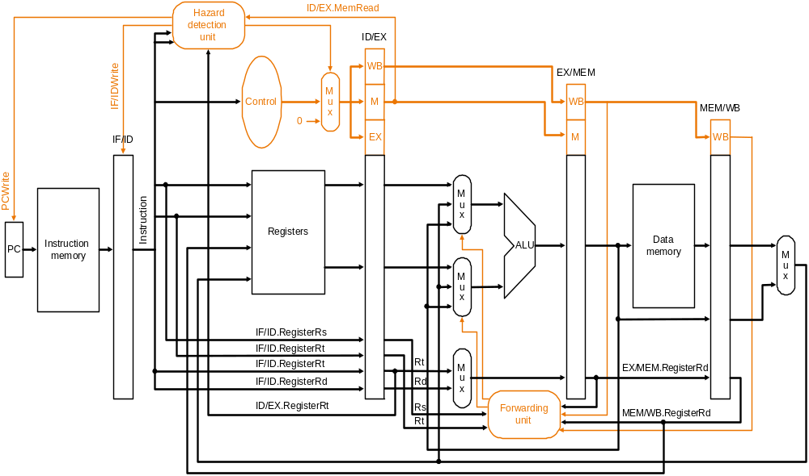
Hazard Detection Unit
Datapath with forwarding hardware, the hazard detection unit and
controls wires – certain details, e.g., branching hardware are omitted
to simplify the drawing

Slide 90
Mechanics of Stalling
If the check to stall verifies, then the pipeline needs to stall only 1 clock cycle after the load as after that the forwarding unit can resolve the dependency
What the hardware does to stall the pipeline 1 cycle:
  does not let the IF/ID register change (disable write!) – this will cause the instruction in the ID stage to repeat, i.e., stall
  therefore, the instruction, just behind, in the IF stage must be stalled as well – so hardware does not let the PC change (disable write!) – this will cause the instruction in the IF stage to repeat, i.e., stall
  changes all the EX, MEM and WB control fields in the ID/EX pipeline register to 0, so effectively the instruction just behind the load becomes a nop – a bubble is said to have been inserted into the pipeline
    note that we cannot turn that instruction into an nop by 0ing all the bits in the instruction itself – recall nop = 00…0 (32 bits) – because it has already been decoded and control signals generated

Slide 91
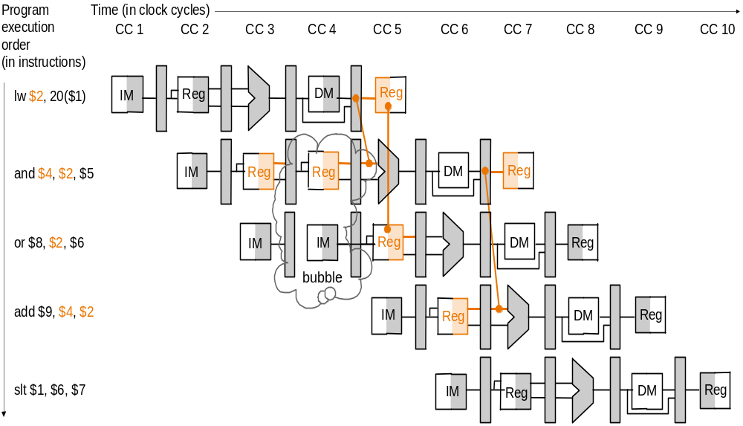
Stalling Resolves a Hazard
Same instruction sequence as before for which forwarding by itself could not resolve the hazard:
lw $2, 20($1)
and $4, $2, $5
or $8, $2, $6
add $9, $4, $2
Slt $1, $6, $7
Hazard detection unit inserts a 1-cycle bubble in the pipeline, after
which all pipeline register dependencies go forward so then the
forwarding unit can handle them and there are no more hazards

Slide 92
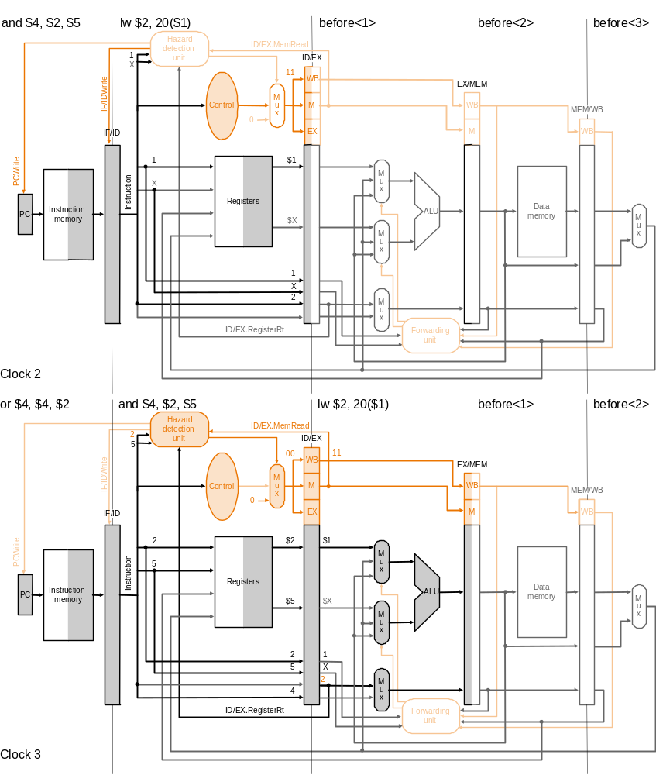
Stalling
Execution
example:
Clock cycle 2
lw $2, 20($1)
and $4, $2, $5
or $4, $4, $2
add $9, $4, $2
Clock cycle 3

Slide 93
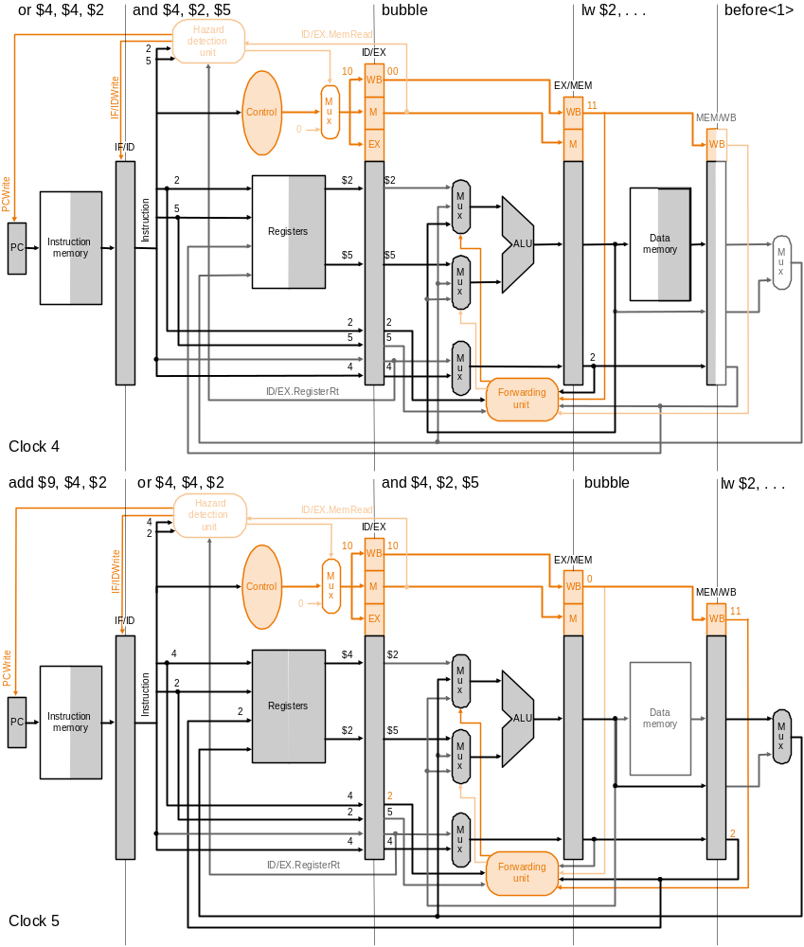
Stalling
Execution
example
(cont.):
Clock cycle 4
lw $2, 20($1)
and $4, $2, $5
or $4, $4, $2
add $9, $4, $2
Clock cycle 5

Slide 94
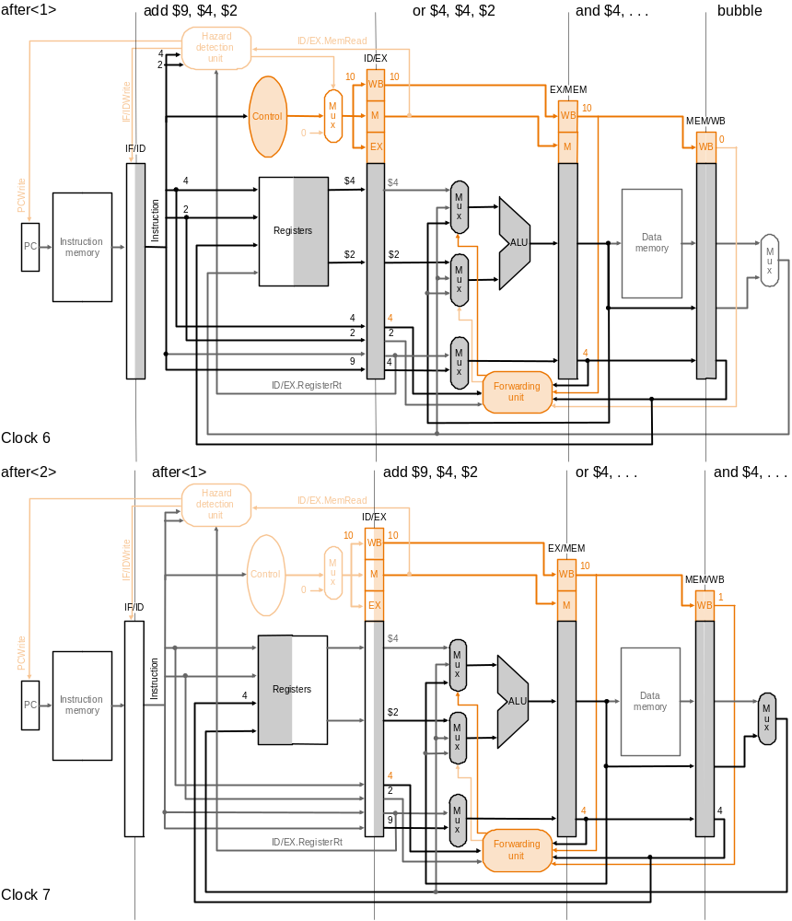
Stalling
Execution
example
(cont.):
Clock cycle 6
lw $2, 20($1)
and $4, $2, $5
or $4, $4, $2
add $9, $4, $2
Clock cycle 7

Slide 95
Control Hazards
Need to make a decision based on the result of a previous instruction still executing in pipeline
Jump and Branch can cause great performance loss
Jump instruction needs only the jump target address
Branch instruction needs two things:
  Branch Result Taken or Not Taken
  Branch Target Address
    PC + 4 If Branch is NOT taken
    PC + 4 + 4 × immediate If Branch is Taken

Slide 96
Control Hazards
Solution 1 Stall the pipeline
Control logic detects a Branch instruction in the 2nd Stage
ALU computes the Branch outcome in the 3rd Stage
Next1 and Next2 instructions will be fetched anyway
Convert Next1 and Next2 into bubbles if branch is taken
Branch outcome is computed in ID stage with added hardware (later…)
cc1
cc2
cc3
cc4
cc5
cc6
cc7
Beq $t1,$t2,L1
IF
Reg
ALU
Next1
IF
Reg
Bubble
Bubble
Bubble
Next2
IF
Bubble
Bubble
Bubble
Bubble
L1: target instruction
Branch
Target
Addr
IF
Reg
ALU
DM

Slide 97
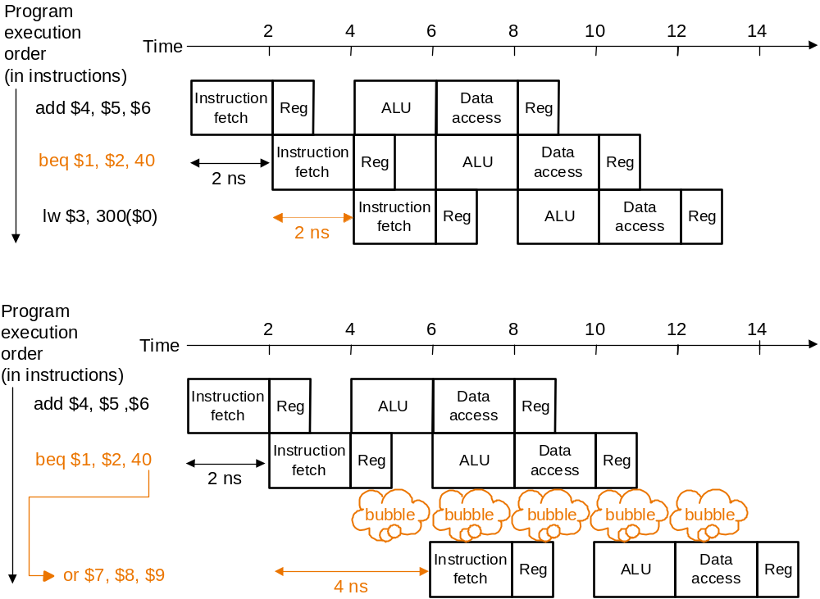
Control Hazards
Solution 2 Predict branch outcome, e.g., predict branch-not-taken :
No waste of cycles, if success
Prediction success
Prediction failure:
undo (=flush) lw

Slide 98
Control Hazards
Solution 3 Delayed branch: always execute the sequentially next statement with the branch executing after one instruction delay
– compiler’s job to find a statement that can be put in the slot that is independent of branch outcome
P
r
o
g
r
a
m
e
x
e
c
u
t
i
o
n
2
4
6
8
1
0
1
2
1
4
o
r
d
e
r
T
i
m
e
(
i
n
i
n
s
t
r
u
c
t
i
o
n
s
)
b
e
q
$
1
,
$
2
,
4
0
I
n
s
t
r
u
c
t
i
o
n
R
e
g
A
L
U
D
a
t
a
R
e
g
f
e
t
c
h
a
c
c
e
s
s
a
d
d
$
4
,
$
5
,
$
6
I
n
s
t
r
u
c
t
i
o
n
R
e
g
A
L
U
D
a
t
a
R
e
g
(
2
n
s
f
e
t
c
h
a
c
c
e
s
s
d
e
l
a
y
e
d
b
r
a
n
c
h
s
l
o
t
)
l
w
$
3
,
3
0
0
(
$
0
)
I
n
s
t
r
u
c
t
i
o
n
R
e
g
A
L
U
D
a
t
a
R
e
g
2
n
s
f
e
t
c
h
a
c
c
e
s
s
2
n
s
Delayed branch beq is followed by add that is independent of branch outcome

Slide 99
Control (or Branch) Hazards
Problem with branches in the pipeline we have so far is that the branch decision is not made till the MEM stage – so what instructions, if at all, should we insert into the pipeline following the branch instructions?
Possible solution: stall the pipeline till branch decision is known
  not efficient, slow the pipeline significantly!
Another solution: predict the branch outcome
  e.g., always predict branch-not-taken – continue with next sequential instructions
  if the prediction is wrong have to flush the pipeline behind the branch – discard instructions already fetched or decoded – and continue execution at the branch target
Is there any other OPTIMAL solution?

Slide 100
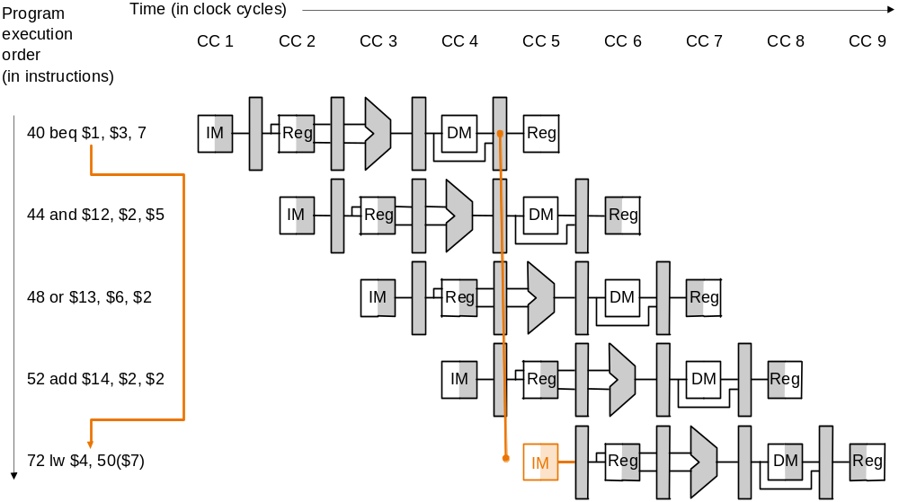
Predicting Branch-not-taken:
Misprediction delay
The outcome of branch taken (prediction wrong) is decided only when
beq is in the MEM stage, so the following three sequential instructions
already in the pipeline have to be flushed and execution resumes at lw

Slide 101
Optimizing the Pipeline to Reduce Branch Delay
Move the branch decision from the MEM stage (as in our current pipeline) earlier to the ID stage
  calculating the branch target address involves moving the branch adder from the MEM stage to the ID stage – inputs to this adder, the PC value and the immediate fields are already available in the IF/ID pipeline register
  calculating the branch decision is efficiently done, e.g., for equality test, by XORing respective bits and then ORing all the results and inverting, rather than using the ALU to subtract and then test for zero (when there is a carry delay)
    with the more efficient equality test we can put it in the ID stage without significantly lengthening this stage – remember an objective of pipeline design is to keep pipeline stages balanced
  we must correspondingly make additions to the forwarding and hazard detection units to forward to or stall the branch at the ID stage in case the branch decision depends on an earlier result

Slide 102
Flushing on Misprediction
Same strategy as for stalling on load-use data hazard…
Zero out all the control values (or the instruction itself) in pipeline registers for the instructions following the branch that are already in the pipeline – effectively turning them into nops – so they are flushed
  in the optimized pipeline, with branch decision made in the ID stage, we have to flush only one instruction in the IF stage – the branch delay penalty is then only one clock cycle

Slide 103
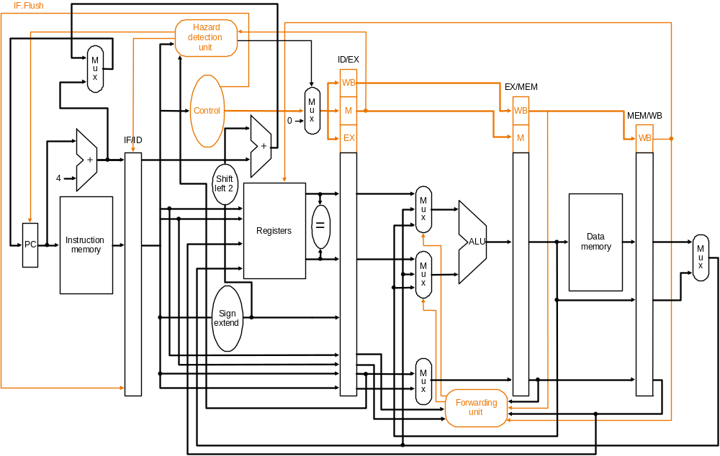
Optimized Datapath for Branch
IF.Flush control zeros out the instruction in the IF/ID
pipeline register (which follows the branch)
Branch decision is moved from the MEM stage to the ID stage – simplified drawing not showing enhancements to the forwarding and hazard detection units

Slide 104
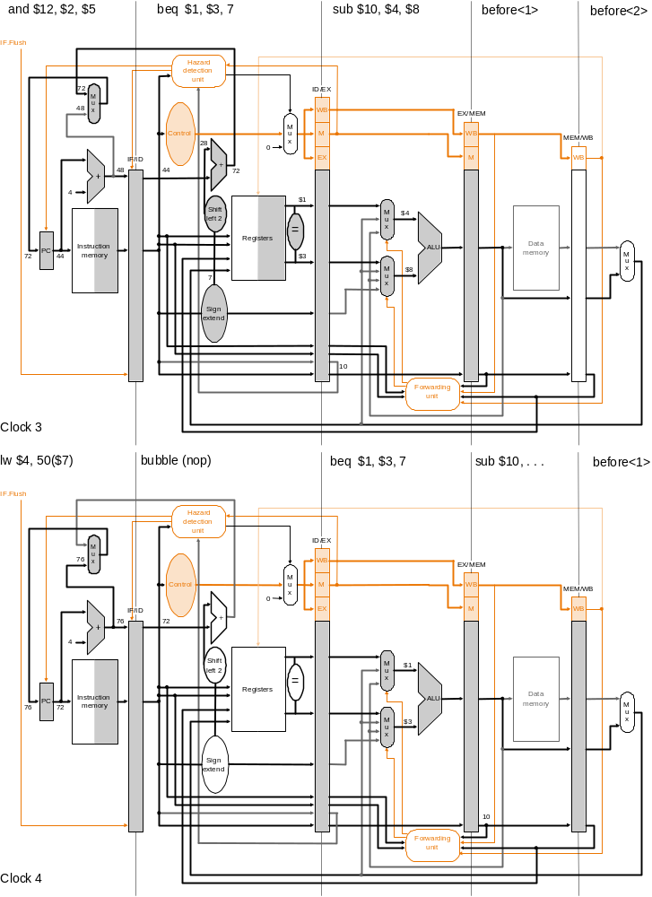
Pipelined
Branch
Execution
example:
Clock cycle 3
36 sub $10, $4, $8
40 beq $1, $3, 7
44 and $12 $2, $5
48 or $13 $2, $6
52 add $14, $4, $2
56 slt $15, $6, $7
…
72 lw $4, 50($7)
Optimized pipeline with
only one bubble as a result
of the taken branch
Clock cycle 4

Slide 105
Simple Example: Comparing Performance
Compare performance for single-cycle, multicycle, and pipelined datapaths using the gcc instruction mix
  assume 2 ns for memory access, 2 ns for ALU operation, 1 ns for register read or write
  assume gcc instruction mix 23% loads, 13% stores, 19% branches, 2% jumps, 43% ALU
  for pipelined execution assume
    50% of the loads are followed immediately by an instruction that uses the result of the load
    25% of branches are mispredicted
    branch delay on misprediction is 1 clock cycle
    jumps always incur 1 clock cycle delay so their average time is 2 clock cycles

Slide 106
Simple Example: Comparing Performance
Single-cycle (p. 373): average instruction time 8 ns
Multicycle (p. 397): average instruction time 8.04 ns
Pipelined:
  loads use 1 cc (clock cycle) when no load-use dependency and 2 cc when there is dependency – given 50% of loads are followed by dependency the average cc per load is 1.5
  stores use 1 cc each
  branches use 1 cc when predicted correctly and 2 cc when not – given 25% misprediction average cc per branch is 1.25
  jumps use 2 cc each
  ALU instructions use 1 cc each
  therefore, average CPI is
  1.5 × 23% + 1 × 13% + 1.25 × 19% + 2 × 2% + 1 × 43% = 1.18
  therefore, average instruction time is 1.18 × 2 = 2.36 ns
    50% of the loads are followed immediately by an instruction that uses the result of the load
    25% of branches are mispredicted
    branch delay on misprediction is 1 clock cycle
    jumps always incur 1 clock cycle delay so their average time is 2 clock cycles

Slide 107
Pipelining Advantages
Higher maximum throughput
Higher utilization of CPU resources
But, more hardware needed, perhaps complex control

Slide 108
Pipelining Exercise
Consider the following MIPS assembly code:
  add $3, $2, $3
  lw $4, 100($3)
  sub $7, $6, $2
  xor $6, $4, $3
Assume there is no forwarding or stalling circuitry in a pipelined processor that uses the standard 5-stages (IF, ID, EX, Mem, WB). Instead, we will require the compiler to add no-ops to the code to ensure correct execution. (Assume that if the processor reads and writes to the same register in a given cycle, the value read out will be the new value that is written in.)
Rewrite the code to include the no-ops that are needed. Do not change the order of the four statements. Use as few no-ops as possible.
Suppose the complier is allowed to change the order of the four statements, provided it doesn’t change the final answer. Is it possible to reduce the number of no-ops needed? Why or why not?

Slide 109
Tutorial Question
Draw an execution diagram that shows where forwarding and stalling would take place, if any.
add $6,$5,$2
lw $7,0($6)
addi $7,$7,10
add $6,$4,$2
sw $7,0($6)
addi $2,$2,4
blt $2,$3,loop
add $6,$5,$2

Slide 110
Refer
Patterson Chapter 6: Topics 6.1 to 6.6

Slide 111
End…

